Slide 1
C R E D I T C O N S U M P T I O N

Slide 2




P R O C E S S
EDA
Feature
Model
Evaluate
1
2
3
4
EDA & PREPROCESS
FEATURE SELECTION
Build Model
Evaluate ML Model
Analyzing Data By Plotting graph
Removing Un-useful Feature From Data
Build model and find accuracy
Model accuracy
and Conclusion

Slide 3
P R O B L E M S T A T E M E N T
COMMON MAN BANK LIMITED.
Banks want to understand the consumption pattern and expenditure of customer to provide discounts or other plans to reward and hold customer
Understanding the spending pattern and profile of the customer banks can alter the loans and propose different financial product based on their profile
Understand relationship between profile of a customer and their usage pattern or expenditure.

Slide 4
Understand these patterns thoroughly and get awareness on the customer personality and their spending pattern for consumption.
Sample customers transaction history is given want to find out mine insights at is (awareness) from the data.
The credit card spend in the previous 3 month April May and June and their expected average spend in the coming 3 month July August September

Slide 5
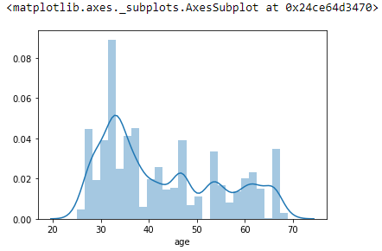
EDA
E D A & P R E P R O C E S S I N G
1
Majority of age group having bank account
Description:
The majority age of people having bank
accounts is between 30-38
mean 42
min 25
max 69
25% 33.0
50% 38.0
75% 53.0

Slide 6
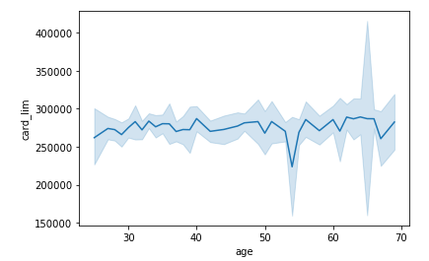
Relationship between age and Card Limit
Description:
In this graph we can see that age between
40-45 has higher card limit
mean 277297.06
min 0.000000
max 1000000.00
Card limit
25% 124000.00
50% 272000.00
75% 400000.00

Slide 7
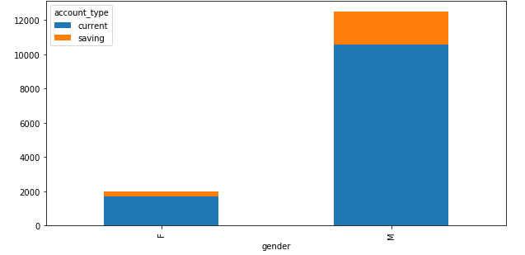
Relationship Between Gender and Account Type
Description:
The majority of males have account
over female And in account type
There Are More Current Account Then
saving account
Account_type
Blue 12259 current
0range 2207 saving
Gender
M 12482
F 1984

Slide 8
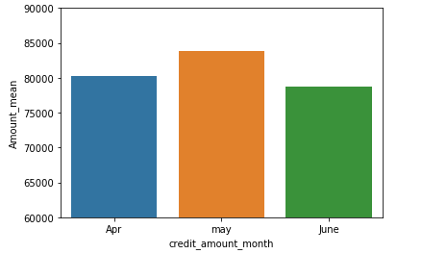
Highest Amount Credited Month
Description:
In this graph we can see that the
amount credited highest was in Month of may
Then April and June
mean 80952.87
std 2572.79
min 78810.62
max 83806.511669
25% 79526.049176
50% 80241.468518
75% 82023.990093

Slide 9
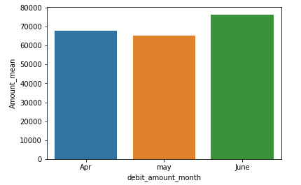
Highest Amount Debited Month
Description:
In this graph we can see that the
amount Debited highest was in Month of June
Then April and may
mean 69930.01
min 65326.78
max 76419.26
25% 66685.39
50% 68044.00
75% 72231.63

Slide 10
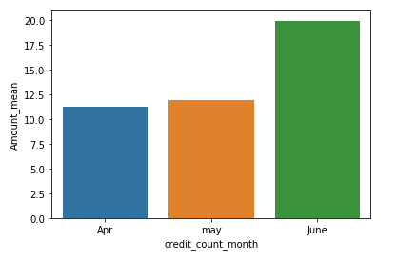
Number of Credit Transaction Count
Description:
In this graph we can see that the Number of
credit count was highest in Month of June
Then April and May
mean 14.38
min 11.30
max 19.94
25% 11.60
50% 11.90
75% 15.92

Slide 11
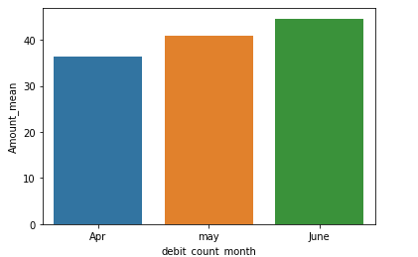
Number of Debit Transaction Count
Description:
In this graph we can see that the Number of
Debit count was highest in Month of June
Then April and May
count 3.000000
mean 40.641873
std 4.096409
min 36.428038
25% 38.657922
50% 40.887806
75% 42.748790
max 44.609775

Slide 12
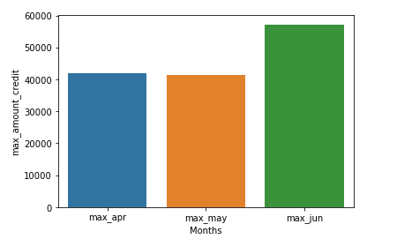
Maximum Credit Amount Month
Description:
In this graph we can see that maximum
amount credited was in the month of june
mean 46811.64
min 41262.78
max 57170.36
25% 41632.28
50% 42001.78
75% 49586.07

Slide 13
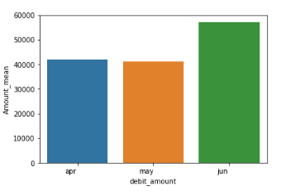
Cardless Transactions
Description:
In this graph we can see that less use of
credit/debit Card was in month of june
Then april and may
mean 46811.645798
max 57170.369063
min 41262.787105
25% 41632.284166
50% 42001.781226
75% 49586.075144

Slide 14
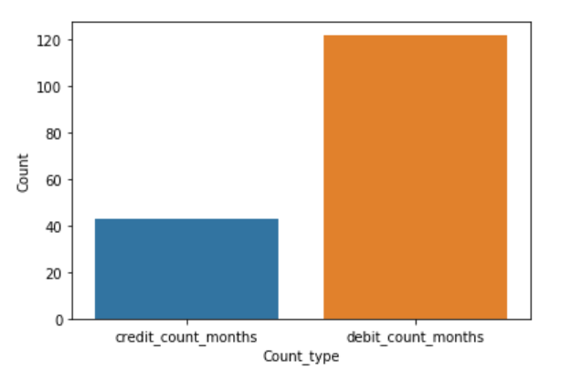
Credit count vs Debit count 3 Months
Description:
In this graph we can see that the maximum
Transaction count was Debit of all 3 months
Then credit count
Total credit count months
624334.0
Total Debit count months
1763776.0

Slide 15
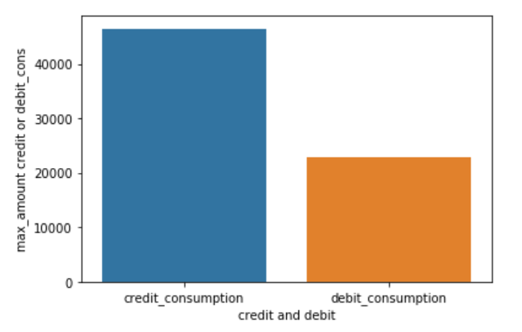
Credit Consumption Vs Debit Consumption in 3 Months
Description:
In this graph we can see that the maximum
Amount Transaction was Credit in 3 months
Total Credit Consumption
671860624.635
Total Debit Consumption
331430519.92

Slide 16
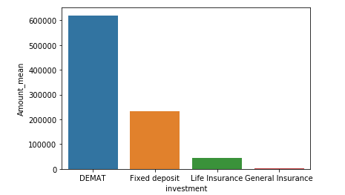
Maximum Investment Type
Description:
In this graph we can see that maximum
amount of money is invested in Demat
And very less in General Insurance
Number of people invested
Demat =619801.318045
Fixed=232274.293313
Life Insurance=44072.345226
General Insurance=3519.800692

Slide 17
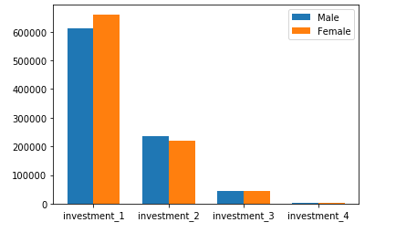
Gender vs Investment Type
Description:
In this graph we are going to see
does gender Effect on investment type
investment 1= DEMAT
investment 2= fixed deposit
investment 3= Life Insurance
investment 4= General Insurance

Slide 18
Feature
F E A T U R E E N G I N E E R I N G
2
DROP COLUMN
'ID' 'personal_loan_active' 'personal_loan_closed' 'vehicle_loan_active' 'vehicle_loan_closed'
'loan_enq'
CAT TO INT Label Encoding
account_type
gender
OUTLIER DETECTION
Almost every Feature was having some outlier we detected using a Outlier function and drop that outliers
STANDARDIZATION
StandardScaler to whole dataset after above process

Slide 19
M O D E L B U L D I N G
Model
3
Model | Parameter | MSE | MAE | R2 | RMSE
Decision Tree | max_depth=None, max_leaf_nodes=None min_samples_leaf=1 min_sample_split=2 | 5.7272 | 1.85 | -1.24 | 2.39
Random Forest | bootstrap=true max_dept=None max_features=auto min_impurity_decrease=0.0 | 2.56 | 1.168 | -0.007 | 1.60
Linear Regression | normalize=false fit_intercept=True | 2.55 | 1.161 | -0.003 | 1.59

Slide 20
Evaluate
M O D E L E V A L U A T I O N
4
EVALUATE- Linear regression
Important Features=There is 6 strongly correlated values with cc_cons:
cc_cons_may 0.021822
cc_count_may 0.016433
credit_count_may 0.013488
investment_3 -0.011453
credit_amount_jun -0.013026
region_code -0.018824

Slide 21
E X E C U T I V E S U M E R Y
We see that the amount been spent by the users is not only from the debit & Credit cards, But also the transactions that did not include cards such as NEFT, Cheque Transfers.
We see that the month of June has generated More Transactions without using card than any other months so can put offer in that month
Offers To Increase: Life Insurance General Insurance
Customers to be targeted Age : 30 - 38 Gender: Male Account Type : Current
Card Limit usage is increase at age group of 40 to 45 so to increase in consumption we should focus on other age group

